Slide 1



CLOUD COMPUTING WITH AWS PROJECT
EMPLOYEE ATTENDANCE TABLE

Slide 2
CONTENTS:
AWS MANAGEMENT CONSOLE
AWS AMPLIFY
AMAZON HONEYCODE BUILDER APP
LINK OF HONEYCODE APP
AMAZON HONEYCODE TEMPLATE
CREATE WORKBOOK PAGE
DEMOWORKBOOK>> EMPLOYEE TABLE
CUSTOMIZATIONS AND SOURCE CODE
OUTPUT TABLE

Slide 3
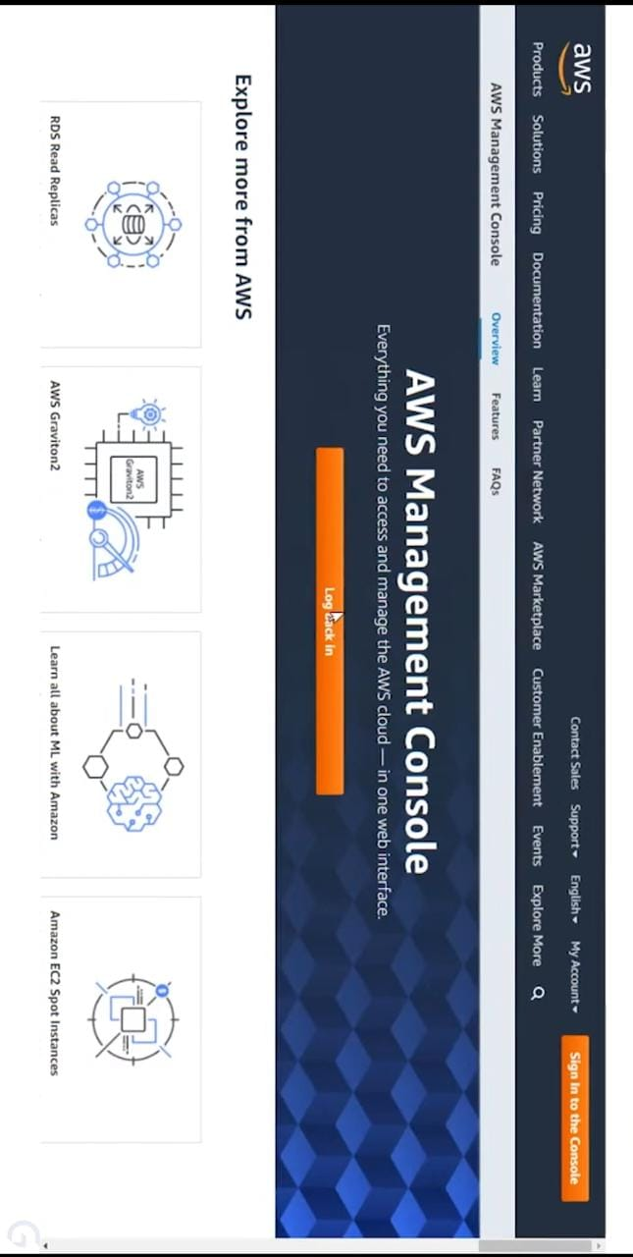
AWS MANAGEMENT CONSOLE
The AWS Management Console is a web application that comprises and refers to a broad collection of service consoles for managing AWS resources. When you first sign in, you see the console home page. The home page provides access to each service console and offers a single place to access the information you need to perform your AWS related tasks.

Slide 4
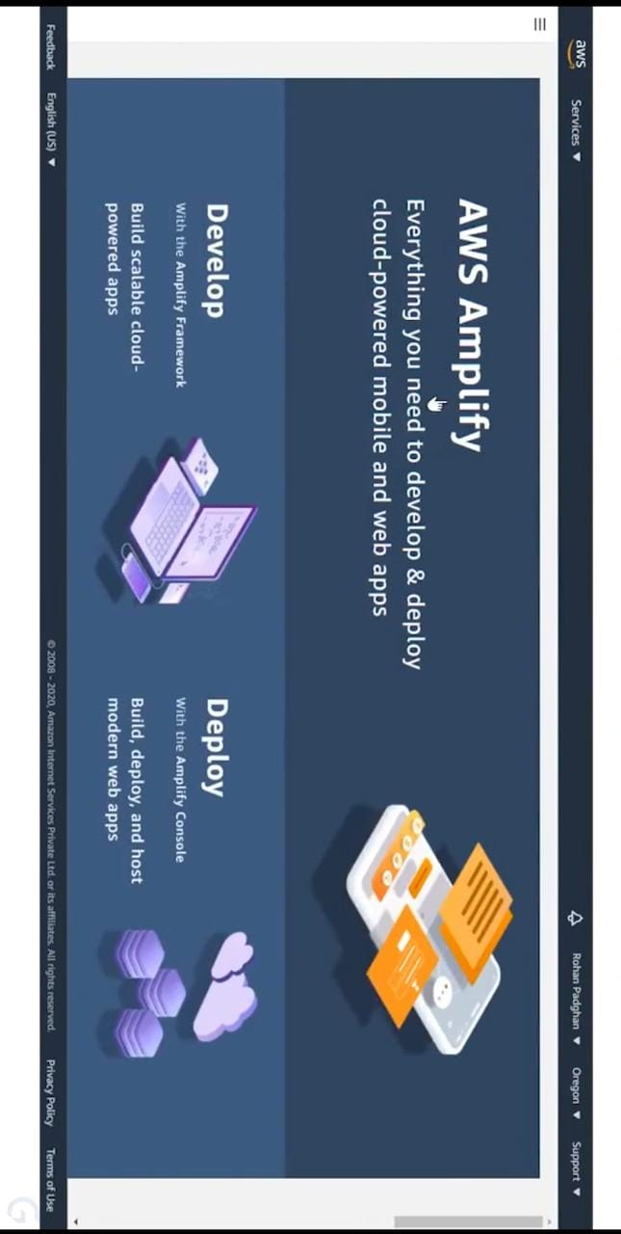
AWS AMPLIFY
AWS Amplify is a complete solution that lets frontend web and mobile developers easily build, ship, and host full-stack applications on AWS, with the flexibility to leverage the breadth of AWS services as use cases evolve. No cloud expertise needed.

Slide 5
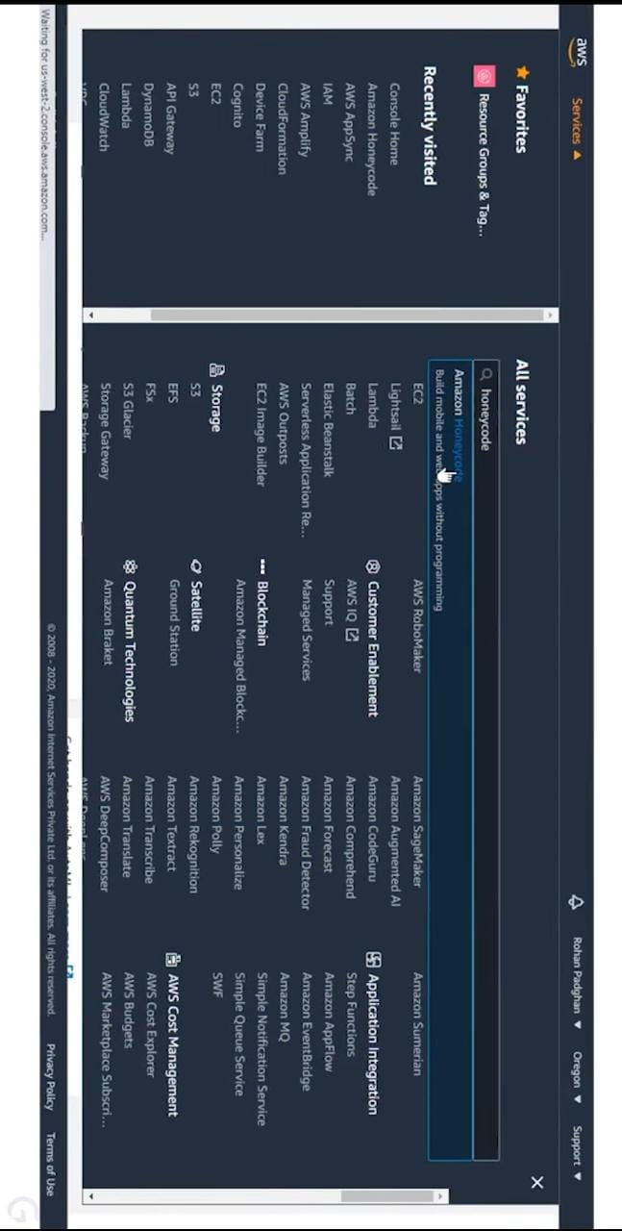
aws honeycode
This new fully-managed AWS service gives you the power to build powerful mobile & web applications without writing any code. It uses the familiar spreadsheet model and lets you get started in minutes.
Amazon Honeycode includes templates for some common applications that you and other members of your team can use right away:

Slide 6

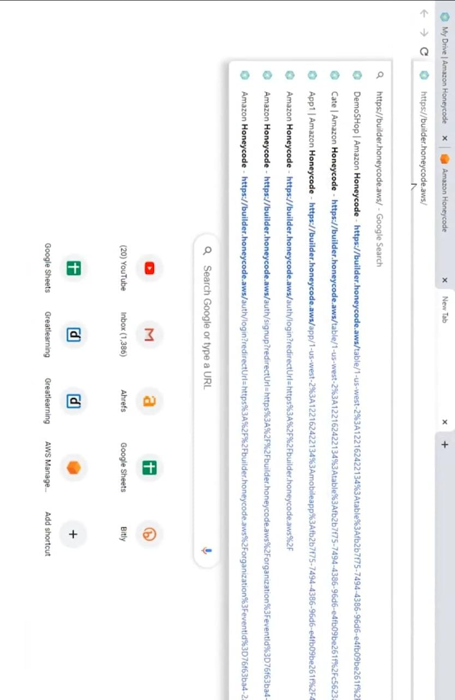
Link/Interface of honeycode builder app

Slide 7
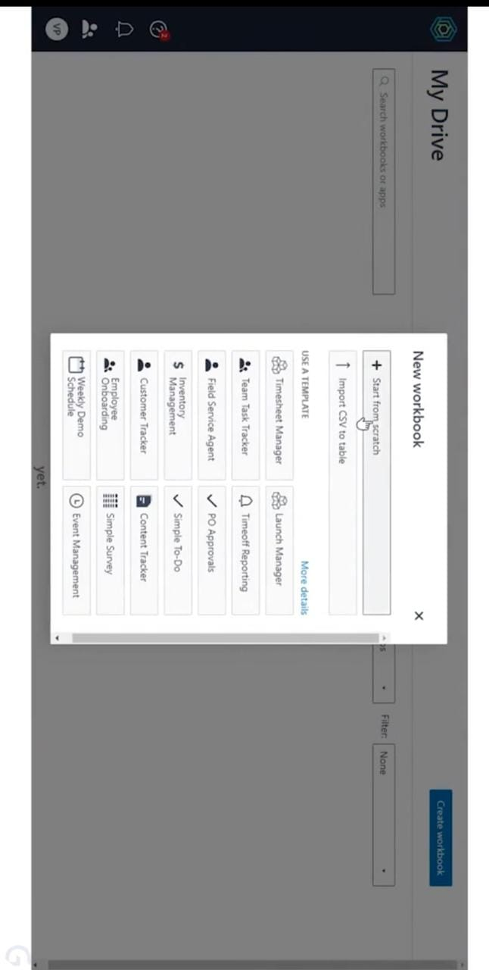
Honeycode Builder Application
You can customize these apps at any time and the changes will be deployed immediately. You can also start with an empty table, or by importing some existing data in CSV form. The applications that you build with Honeycode can make use of a rich palette of user interface objects including lists, buttons, and input fields

Slide 8
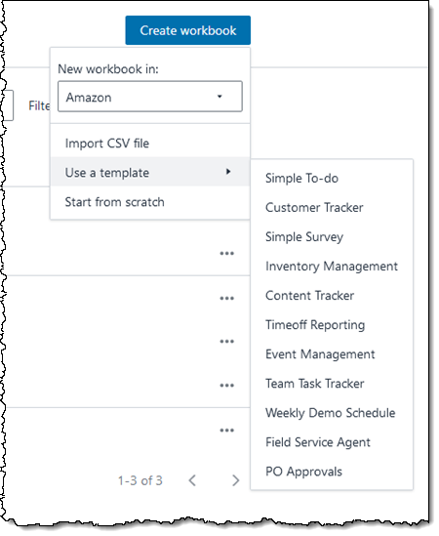
CREATE WORKBOOK INTERFACE
You can click Create workbook to make something new. Do that, and then select the Simple To-do template:

Slide 9
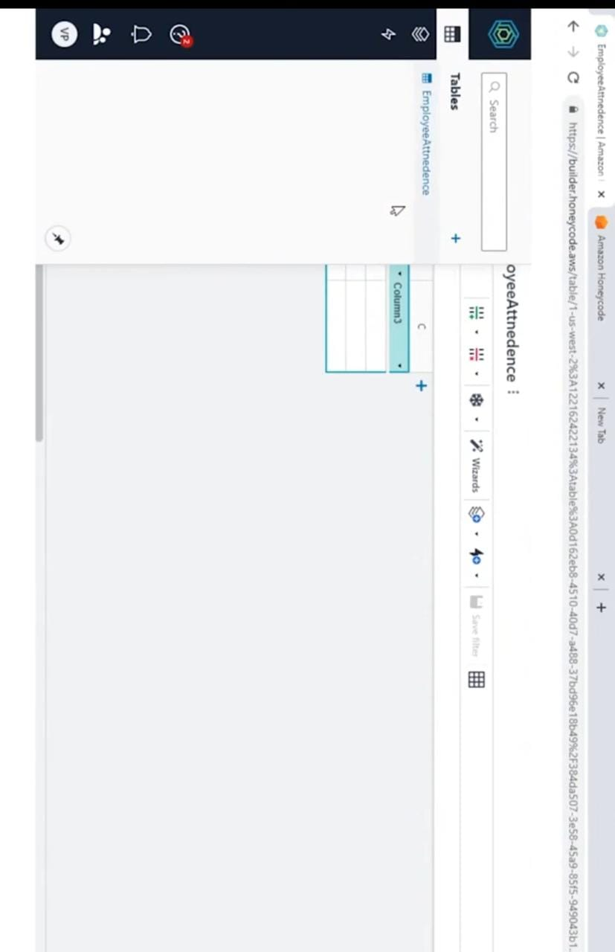
CREATE TABLE>> EMPLOYEE ATTENDANCE

Slide 10
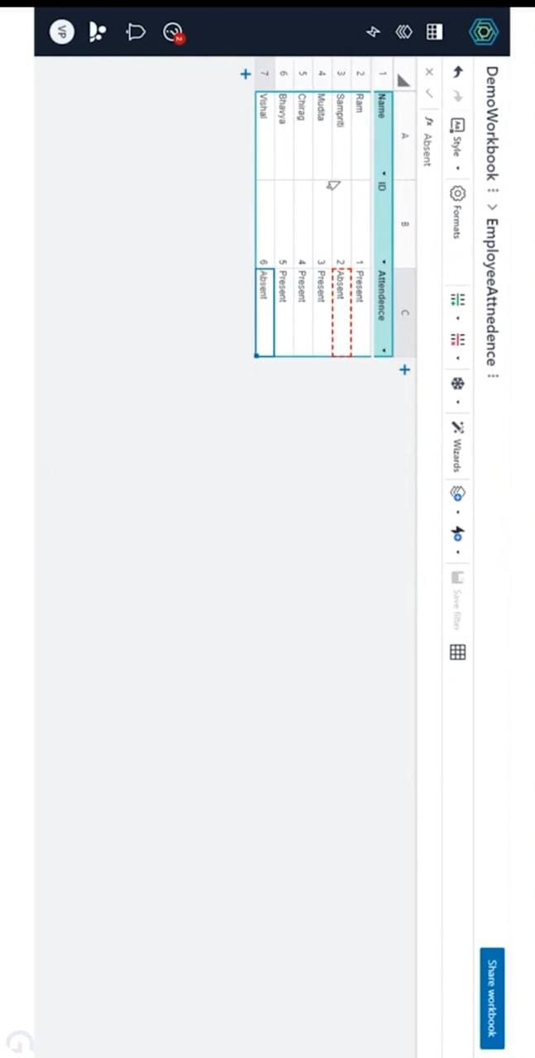
STRUCTURE
Add Colums
Give Colums Name
Enrter Randomn Inputs

Slide 11
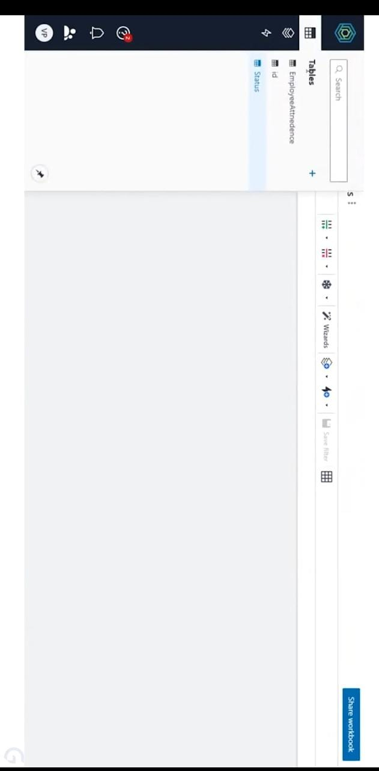
STRUCTURE
Add 2 more TABLES
Give Name Same as Employee Attendance Column names Respectively i.e. id and status.

Slide 12
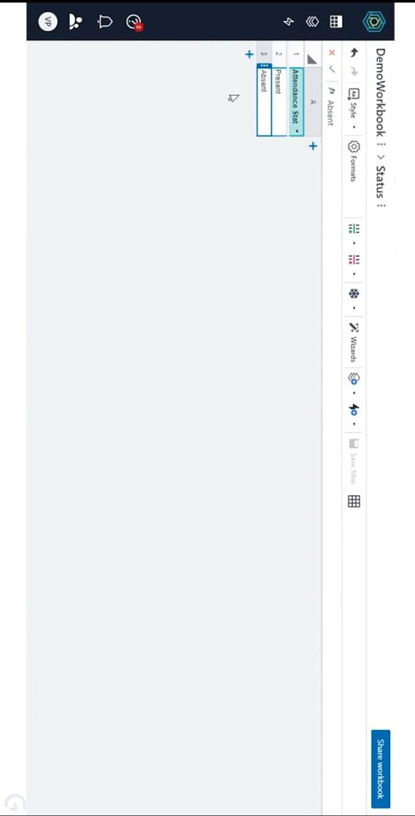
STRUCTURE
Open Status table
Assign attributes Present and Absent.

Slide 13
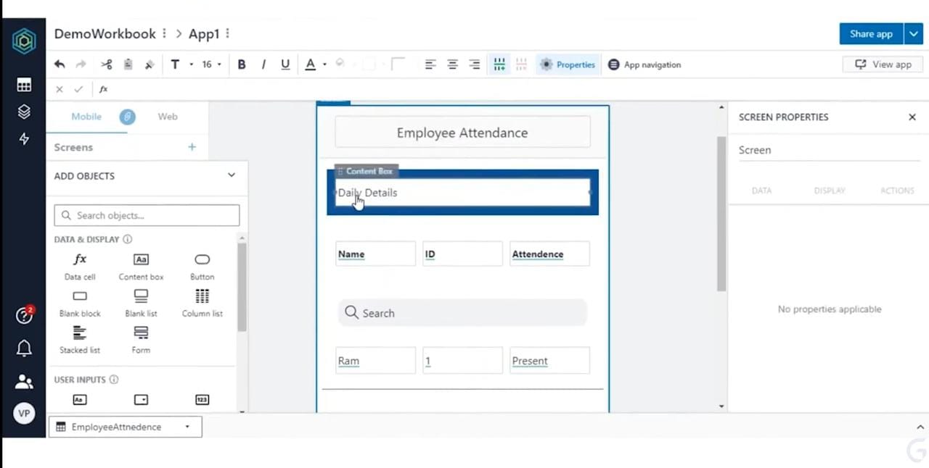
STRUCTURE

Slide 14
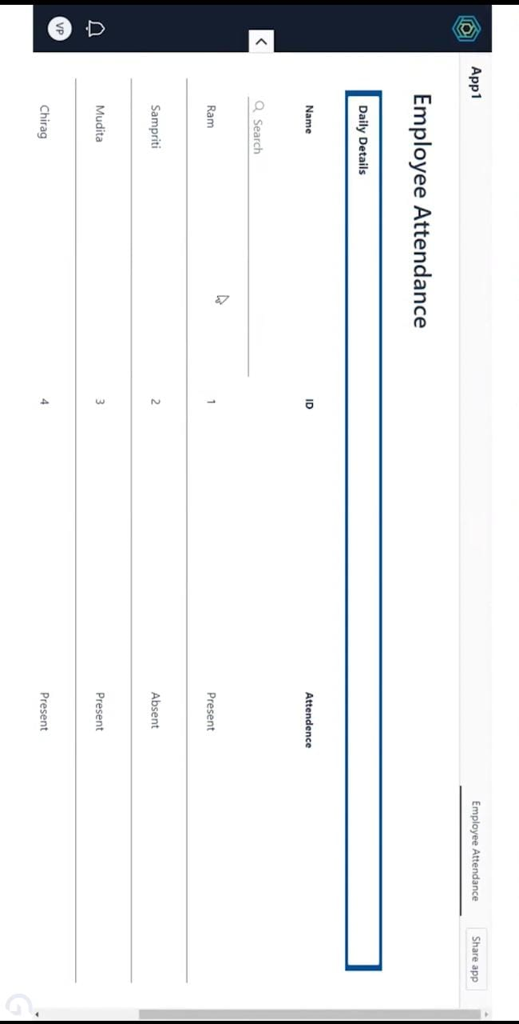
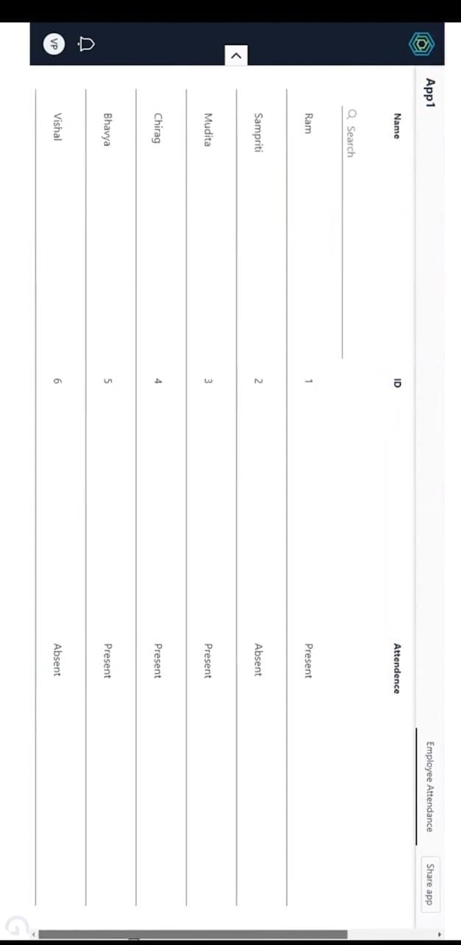
Employee Attendance Table

Slide 15

SOURCE CODE
Name,ID,Attendence
Ram,1,Present
Sampriti,2,Absent
Mudita,3,Present
Chirag,4,Present
Bhavya,5,Absent
Vishal,6,Present

Slide 16
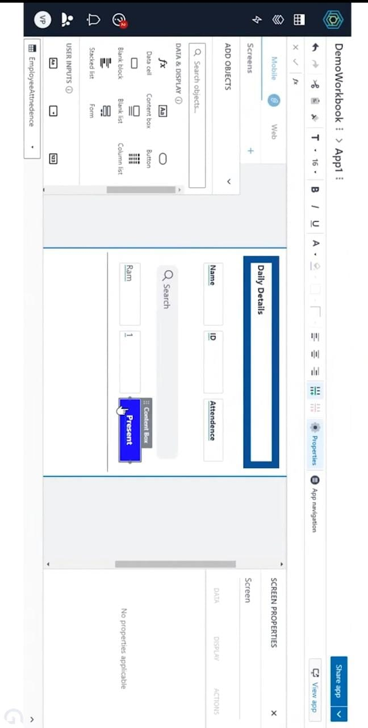
CUSTOMIZATION
Change Daily Details Border Colour To “ Dark Blue”.
Change Present colour Box Color also to BLUE.

Slide 17
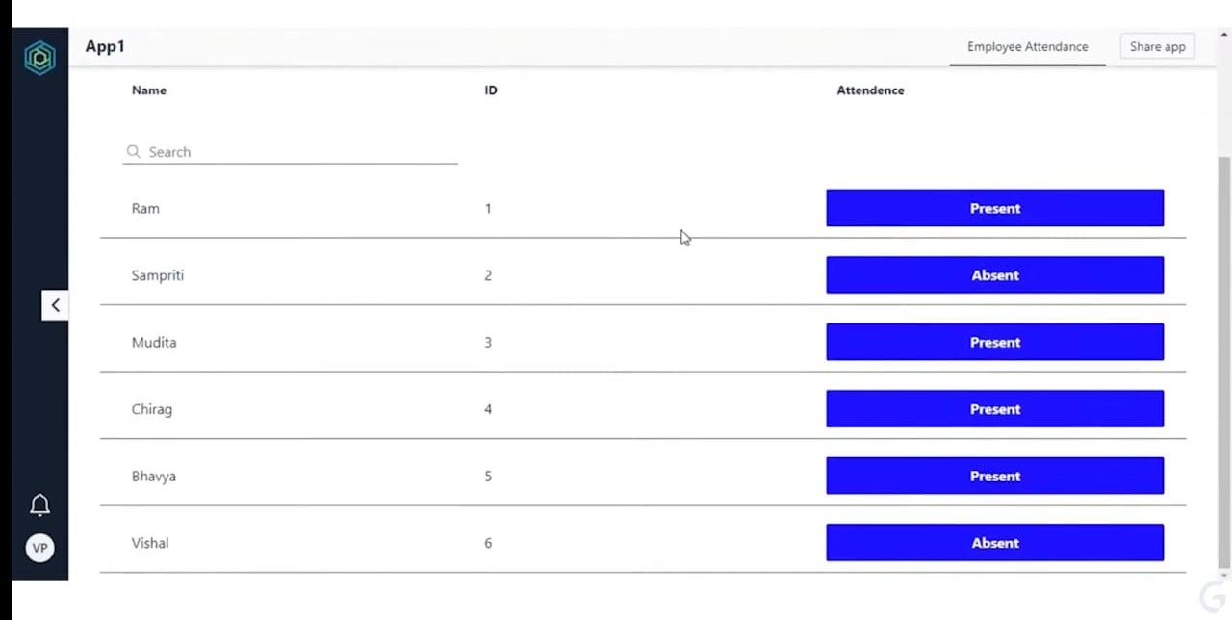
EMPLOYEE ATTENDANCE TABLE

Slide 18
THANK YOU

